Slide 1
Observations about making collective sense of technological change opportunities in the manufacturing sector
TIPS Development Dialogue
08 October 2024

Slide 2
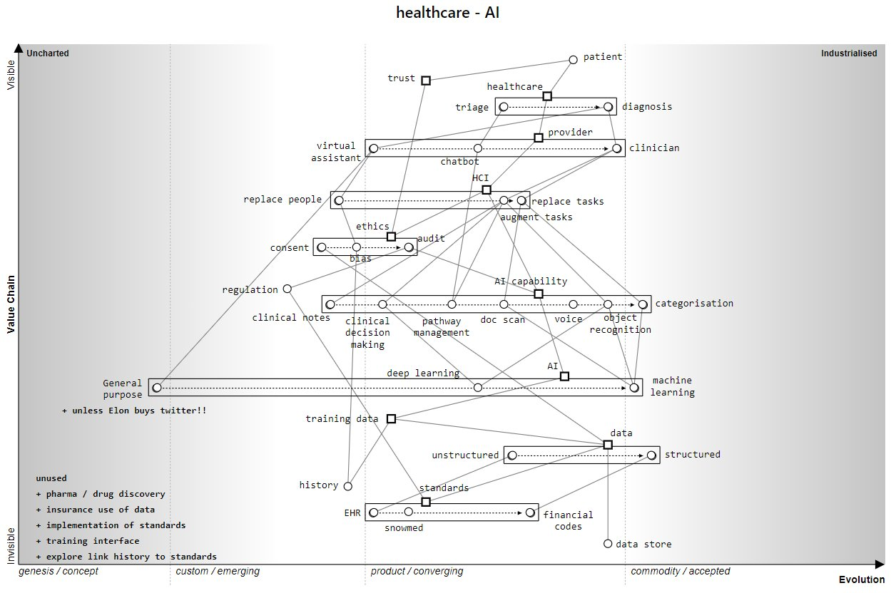
We must improve our ability to create a distributed understanding of technological change possibilities.
Technology is often framed as “disruptive” - a reactive posture.
Technology is mainly seen as an object, not as physical or social technologies that must be integrated to achieve a purpose.
Technologies change in predictable patterns; it is possible to formulate defensive and offensive strategies.
Image from Simon Wardley, AI in Healthcare Research Group (2023, UK)

Slide 3
Seven observations I will talk about..
Improving our ability to create a distributed understanding of technological change possibilities.
Sector strategies often focus on challenges, threats, and disruption; not on competencies, learning and solving problems.
It is expensive to scan multiple tech & market horizons
We underestimate the importance of building complementary or co-specialised competencies.
Public sector technology support is often generic and responsive. Not proactive or focused on sector competitiveness.
Tech Change is seen as an outcome, not a learning process.
It is assumed that all firms use technology in the same way

Slide 4
Sector strategy processes often discuss technological challenges, threats, and opportunities.
…but are reduced to skills development, specific technology development projects, or awareness raising during implementation.
More attention should be paid to learning:
What is possible?
What do we have that can be repurposed?
What competencies should we explore or try as options for tomorrow?
How do we coordinate investments?
Creating sand cores using 3D printer - experiment (2013)

Slide 5
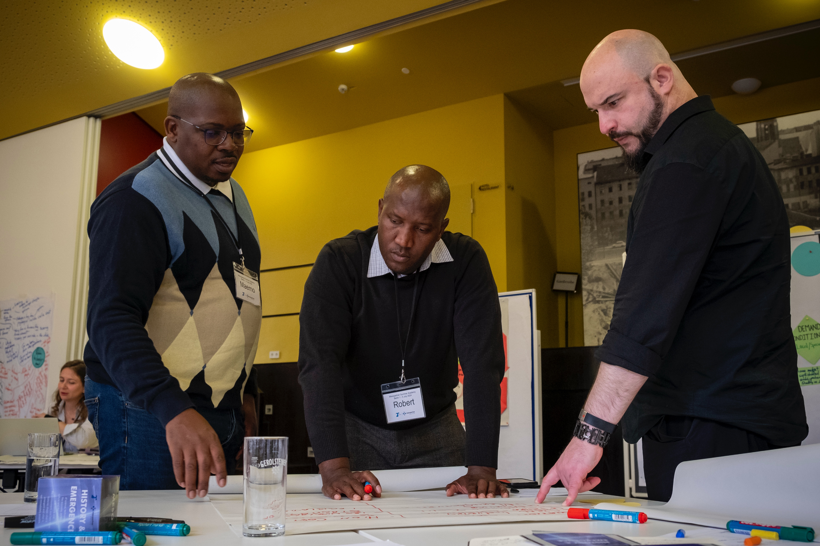
It is expensive to scan multiple technology and market horizons independently
Knowledge is increasingly spread over different organisations and functions.
Those with deep expertise or pockets can learn independently about new technological possibilities.
Most domestic manufacturers are learning about proven technologies already established in the local market (off-the-shelf solutions).
Technology information is disseminated through associations, trade magazines, and equipment suppliers.
VUT Technology Station team reflecting on technological change (2024)

Slide 6
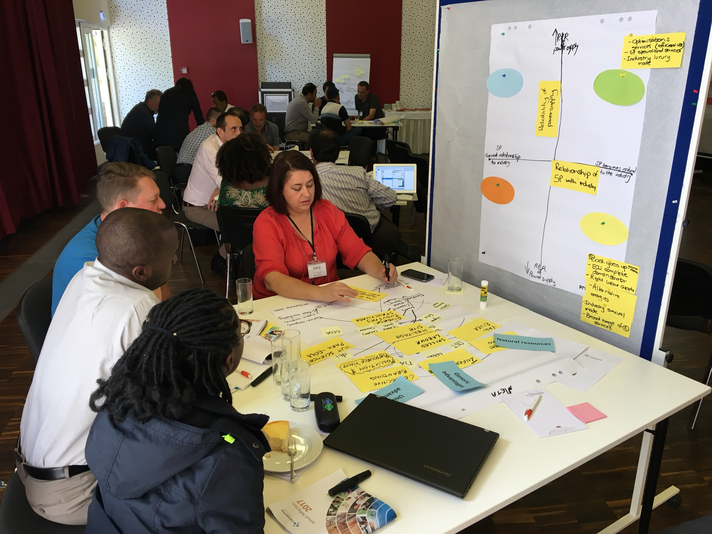
We underestimate the importance of building complementary or co-specialised competencies.
The search costs to detect unique competencies in the private and public sectors are high.
Investments in new markets and technologies often require complementary or co-specialised investments that require coordination.
A team from the VUT reflect on their strategy in the broader Vaal industrial region

Slide 7
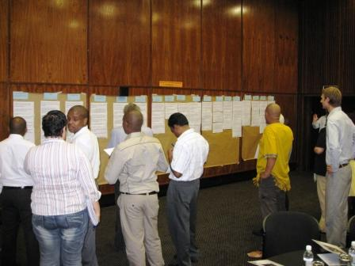
Public sector technology support is often generic and responsive.
Many functional overlaps, gaps and synchronisation challenges between organisations.
Missing public goods,
There are high coordination costs between programmes
Yet, there are excellent public capabilities that are hard to find
Public technology promotion is measured against narrow measures at firm level.
Publicly funded research is often exclusive and often has lower spillover effects.
Foundry industry and supporting institutions map expectations and competencies (2011)

Slide 8
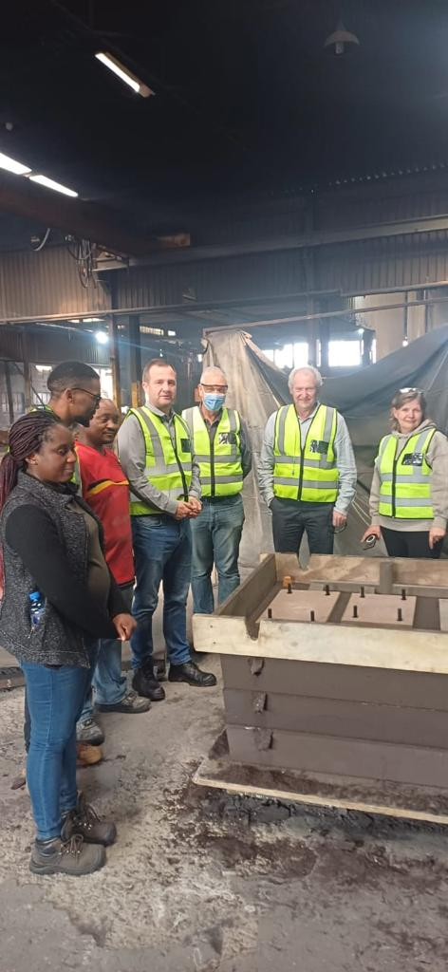
Technological change is seen as an outcome
…like a product, process or measurable change.
It is not a strategy or strategy or perspective of learning intentionally
Solving problems,
building competencies or
exploring new upgrading possibilities collectively.
Within and between companies
Foundry staff explain their experiment with a mould. HiAlloycastings, 2023

Slide 9
Strategies are hampered by thinking of firms as the same.
It is often assumed that all firms in a sub-sector use technologies similarly
and
that technologies have the same effects, functions, and implications for all organisations.

Slide 10
What do we need to do?
Reframe technology as “knowing how to do things” AND “knowing how to organise people to achieve shared objectives”.
Emphasise learning within networks of public and private actors.
Shift from responding faster to proactively creating new specialised competencies.
Use public technological support to create complementary capabilities that make industries more competitive – induce upgrading!
Measure public technology dissemination on the upgrading and increased performance of sub-sectors or markets.
Work with industry associations or networks to collectively make sense of possibilities and encourage technological innovation.
Work more with coalitions of the willing.

Slide 11
Dr Shawn Cunningham sc@mesopartner.com https://www.tips.org.za/projects/technological-change-and-innovation-system-observatory
Thank you for your attention

